Slide 1

From Job Adverts to National Accounts
Using AI to Measure Data as an Asset in the UK Economy
NACD Divisional Meeting

Slide 2




The Challenge & The Solution
The Blind Spot
OECD Sum-of-Costs
Unmeasured Intangible Data
Value = Cost of Human Labor

Slide 3




The Flaw in "Job Titles"
Software Engineer
SOC 4114: Data Entry
The Standard Assumption
The Hidden Workforce

Slide 4
The Alternative Data Engine
62.3M
5 Years of Historical Data
PySpark NLP Pipeline
Raw Job Adverts

Slide 5

The AI Filtration Pipeline
1
2
3
0.35 Cosine
10.0x Share
0.45 Polish
Semantic Boundary
Anchor vs. Economy
Gold Standard Test

Slide 6

Classification & Mapping
Classification
≥ 3 Distinct Terms
Allocation
Probabilistic Crosswalk (SOC → SIC)

Slide 7

The Valuation Framework
CoE
α Multiplier
Compensation of Employees
Overheads & Surplus

Slide 8




Methodological Limitations
Flow vs. Stock
Internal Tools
Conservative
Hiring intent ≠ existing workforce.
Proprietary systems are missed.
Precision prioritized over recall.

Slide 9
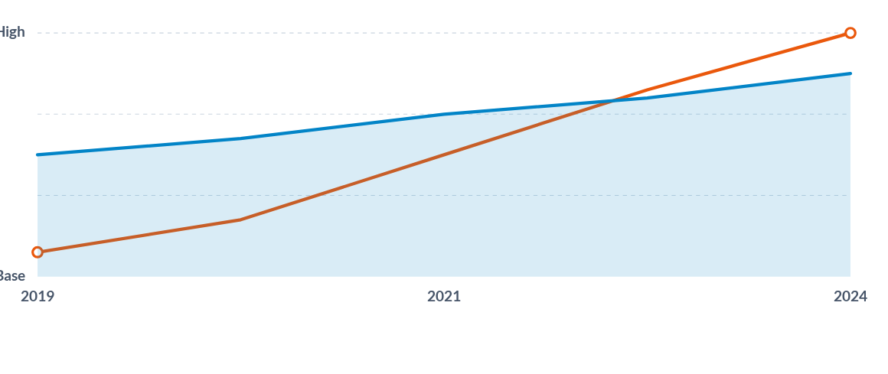
Structural Economic Shifts
Data capital formation is universally integrated beyond traditional tech.

Slide 10
Real-Time Tracking
Questions?
Scalable Architecture
National Accounts Ready

